Slide 1
Computer Operating Systems
Presentation 02

Slide 2
Computer Operating Systems
We can generally categorize operating systems depending on what they are used for, who can access them and what kind of environment they offer.
Different types of operating systems can include:
Single User
Multi User
Mobile Operating Systems
Embedded Systems

Slide 3
Single User Operating Systems
We can deem a system as single-user, if the OS provides support for only one user at a time.
As well as only providing support for one user, we can split this category of OS into two distinct types:
Single –User, Single Tasking
Single-User, Multi Tasking

Slide 4

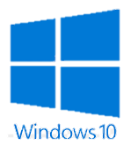
Single User Operating Systems
Single-User, Single-Tasking
These systems are designed to deal with only one user at a time, who is using only one application or process at a time. An example of this being MS-DOS.
Single-User, Multi-Tasking
Again, these systems only allow for one single user to use the system at the one time, but allow the user to use multiple applications or processes at the same time. An example of this type of system is Windows 10.
*It should be remembered that even though operating systems such as Windows 10 allow user to have multiple profiles on the system, only one profile can log in and physically use the system at any one time. Therefor this makes it a single-user system.

Slide 5
Single User Operating Systems
These types of systems are generally designed for home use, where only one user would be required to be logged onto the system at any given time.
There are advantages to these types of systems. Due to the system only having one user using the system, the OS does not have to deal with multiple interrupts from multiple users. This then prevents the system hardware not to be overloaded.

Slide 6
Multi-User Operating Systems
Unlike single-user systems, multi-user operating systems allows access to more than one user at any given time.
Most multi-user systems support all of the same features of a single-user system, the difference is that they allow multiple users access to multiple application and processes at the same time.
This is usually carried out through terminals that connect to a single systems operating system via a network.
Although it possible to carry out the same tasks on a Multi-User OS as it is with a single-user OS, due to the system having to share resources between multiple connected users, these systems tend to take up more resources than single user systems.

Slide 7
Multi-User Operating Systems
The type of multi-user operating system that is being used can be determined due to the way that the system shares resources.
For Example
Multi-Processor (Parallel) Systems
Two or more Central Processing Units (CPU’s) share the same resources and service the same work.
Time-Sliced (Time-Sharing) System
The processor will switch from one process to another on a timed basis.
Distributed Operating Systems
Distributed processing is a technique of distributing the tasks over a number of devices, taking advantage of the large pool of resources.

Slide 8
Multi-User Operating Systems
In order for any system to be a true Multi-User system, the following features must be provided:
Resource Sharing
Multi-tasking
Background Processing

Slide 9
Resource Sharing
Types of resources that can be shared include the CPU, memory, data and peripheral devices.
The OS must manage resources in a way that will ensure that all processes eventually get enough resources in order to complete their required tasks.
If a process does not get enough resources then the task will die of starvation.
There are however a number of constraints in relation to any plan for scheduling processes.

Slide 10
Resource Sharing
System Capacity constrains the overall output. For example, a more powerful processor can handle more processes in a given amount of time. The same reasoning applies to the amount of memory available.
Nature of Workload constrains the predictability as types of processes may vary radically. Some may be CPU intensive such as statistical analysis, where as some may require a large amount of input/output such as database applications.
Conservation Laws act as a constraint on user response time. It is a description of how some aims are contradictory. For example, response time turnaround. In order to maintain response time, interactive users; the scheduler(which controls resource allocation) should not run any batch jobs at all. This would obviously provide no resources what-so-ever to the batch user which would lead to starvation.

Slide 11
Multi - Tasking
Multi-tasking is another feature of multi-user systems.
Multi-tasking involves a system performing two or more tasks apparently simultaneously.
Each time a new application or process is added, the performance of each application or process is reduced.
There are two main types of multi-tasking
Co-operative that will allow processes to run until completion and only then is a process switch permitted. This mostly used by single user OS such as Windows.
Pre-emptive allows processes to be suspended at any time and other processes to be permitted to take control of the CPU. This is mostly used by multi-user systems such as Linux.

Slide 12
Multi - Tasking
Advantages of Multi-Tasking include:
Sharing one CPU amongst many users
Processes executing simultaneously
More efficient of the available resources
Disadvantages of Multi-Tasking include:
The CPU scheduler will be more complex
Each context switch takes up a finite amount of the processors time. This overhead is effectively lost time, as a context switch in itself carries out no useful purpose other than swapping out the current process that is executing and replacing it with another.
In addition to this wasted time, there is a storage overhead as there must be a mechanism to store the processes that are being swapped in and out of the processor.

Slide 13
Background Processing
When processes run in a Multi-User operating system, they can either be in the foreground or in the background.
Foreground Processes
While a user is logged into the system, all the processes that are initiated by the user are being processed at that time or in the foreground. This way of working is sometimes called conversational (interactive) mode of working.
Background Processes
If the user does not want to run a particular process at that time but instead wants to run it later.
Why? – some processes consume a considerable amount of system resources and would degrade the performance of other foreground processes so the user may decide to run it during a quiet period such as overnight.

Slide 14
Mobile Operating Systems

Slide 15
Mobile Operating Systems
As well as desktop systems, mobile systems also require an operating system for the hardware to be able to carry out tasks.
Mobile devices can include mobile phones, tablets and smart watches.
Like with other operating systems, mobile operating systems provide an interface for the user on which they can access the other applications and utilise the features of the device.
The operating system on a mobile device not only allows user interaction but also determines what other applications can be ran on the device, as well as managing the devices settings and hardware.

Slide 16
Types of Mobile OS
While there are a number of different types of desktop systems available, this also true for mobile operating systems.
We can generally split mobile operating systems into 2 categories, just as we can with desktop systems:
Open Source
Closed Source
The line between these types of operating system is becoming more of a blur as technology is evolving as we will see.

Slide 17

Closed Source Mobile Systems
Closed source systems, sometimes referred to as a ‘Walled Garden’ system, is an operating system where the provider has control over the services and applications that the user can use.
All apps/programs that are available to install, are provided by the developer. You are unable to install any other applications.
There is not much flexibility in terms of the way that you are able to customize these systems due to the restrictions that are placed on applications.

Slide 18
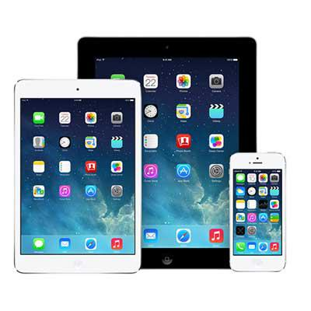
Closed Source Mobile Systems
The support that is received with these systems however, is generally better than that of other types of systems.
This also goes for the security that is installed on these systems. Being created and tested in a closed environment, as well as the limited access to the source code contributed to this.
There is also greater integration between compatible devices with closed source systems as well as an unified interface across mobile devices .

Slide 19
Closed Source Mobile Systems
The source code for these systems is not explicitly available, this means that app developers are unable to create apps that are compatible with the OS.
To overcome this issue, while continuing to restrict access to the source code, closed source developers provide an application programming interface (API), to allow app developers to create programs to run on the closed OS.
Examples of closed source mobile operating systems are, Amazon Kindle firmware and Apples iOS.

Slide 20
Open Source Operating System
Unlike closed source, the code for open source systems is available to all.
It is possible to download and install apps from almost any source. There are no restrictions on the applications that are installed.
These systems tend to be extremely customizable, allowing you to change features such as keyboards and default apps for browsing etc.

Slide 21
Open Source Operating System
With the system being open source, this has created a large support community. There are a number of communities available that offer support and code for users and developers.
Where we tend to be limited in the devices that we can choose when it comes to closed source operating systems, open source systems are used by a greater variety of hardware manufacturers.
This doesn’t mean that each manufacturer offers us the same user experience, because due to the ability to customize the source code, they are able to amend this to suit the needs of their devices.
Examples of mobile open source systems include Ubuntu Touch and Tizen.

Slide 22
Android
Android is an OS that we are all familiar with.
It is a mobile system that is based on the Linux kernel, which is open source.
Although the Android itself is open source, this means that manufacturers and developers have the ability to amend the source code to suit their needs and then essentially run this as closed source software.
Because of this there has been some debate as to whether Android is completely open source.

Slide 23
Embedded Operating Systems

Slide 24
Embedded Operating Systems
Unlike operating systems designed for desktop or mobile devices, embedded operating systems are designed to carry out a specific task, not multiple.
The devices that run embedded operating systems, typically have limited hardware resources, therefore are designed to be efficient and compact.
Within a typical desktop system, the user is able to execute certain applications at their request. This is not the case for embedded systems where the system is usually designed as a single executable shell.

Slide 25
Embedded Operating Systems
This shell is generally executed from the boot of the machine, not from a desktop.
Where a standard operating system creates an interactive environment between the user and the computer, an embedded system requires no, or little user input.
These operating systems, rather being installed on the hard disk like a traditional OS, are installed into the firmware of the device by the manufacturer and are typically not user installed.

Slide 26
Embedded Operating Systems
These systems are commonly small systems, with one specific task that play a part within a larger system. An example being the breaking system within a car.
Generally, these systems are expected not only to continue to repeat the task that they are programed to do but also to perform the task within a specific time.
If we take the example of a cars ABS again, if there is a delay in the system then then there’s the potential to cause an accident.

Slide 27
Embedded Operating Systems
We often split embedded operating systems up into 4 categories:
Real Time Embedded Systems
Stand Alone Embedded Systems
Networked Embedded Systems
Mobile Embedded Systems

Slide 28
Real Time Embedded Systems
A real-time embedded system, is one where the system needs to respond within a strict time.
This time is usually defined as a response to a request or event there for does not waste time on processing if the event doesn’t occur.
Real Time systems can be sub-categorised into 3 types:
Hard Real Time Systems
Soft Real Time Systems
Firm Real Time Systems
Examples of real time embedded systems include, air traffic control systems, military drones and aero space probes.

Slide 29
Stand Alone Embedded Systems
Where a number of Embedded Systems operate within a larger system, or host system, this is not the case for stand alone embedded systems.
These systems work on their own by taking an input, either digital or analogue and processes it.
It then passes the output to a connected device or service.
Examples of stand alone systems include MP3 players, game consoles and calculators

Slide 30
Network Embedded Systems
Like the name suggests, Network Embedded Systems depend on being connected to a network to access resources.
This can be any connection, such as being connected to a LAN or WAN, and can be either wired or wireless.
These systems communicate with a central device such as server.
They commonly consist of sensors etc which are all connected and managed from a central point.
Examples of Network Embedded Systems include, home security systems, ATMs and chip and pin card machines

Slide 31
Mobile Embedded Systems
Mobile embedded systems are small in size. This means that they can be used within small portable devices.
These systems generally have memory constraints which serves as a limitation. They are also often restricted with other hardware resources.
They are also not limited to mobile phones but also other small devices such as digital cameras and digital personal assistants.

Slide 32
For Next Week ……
These slides will be available on Moodle.
There is also a tutorial, available on Moodle.
This is expected to be completed and submitted to the hand-in on Moodle for next week.

Slide 33
Environments

Slide 34
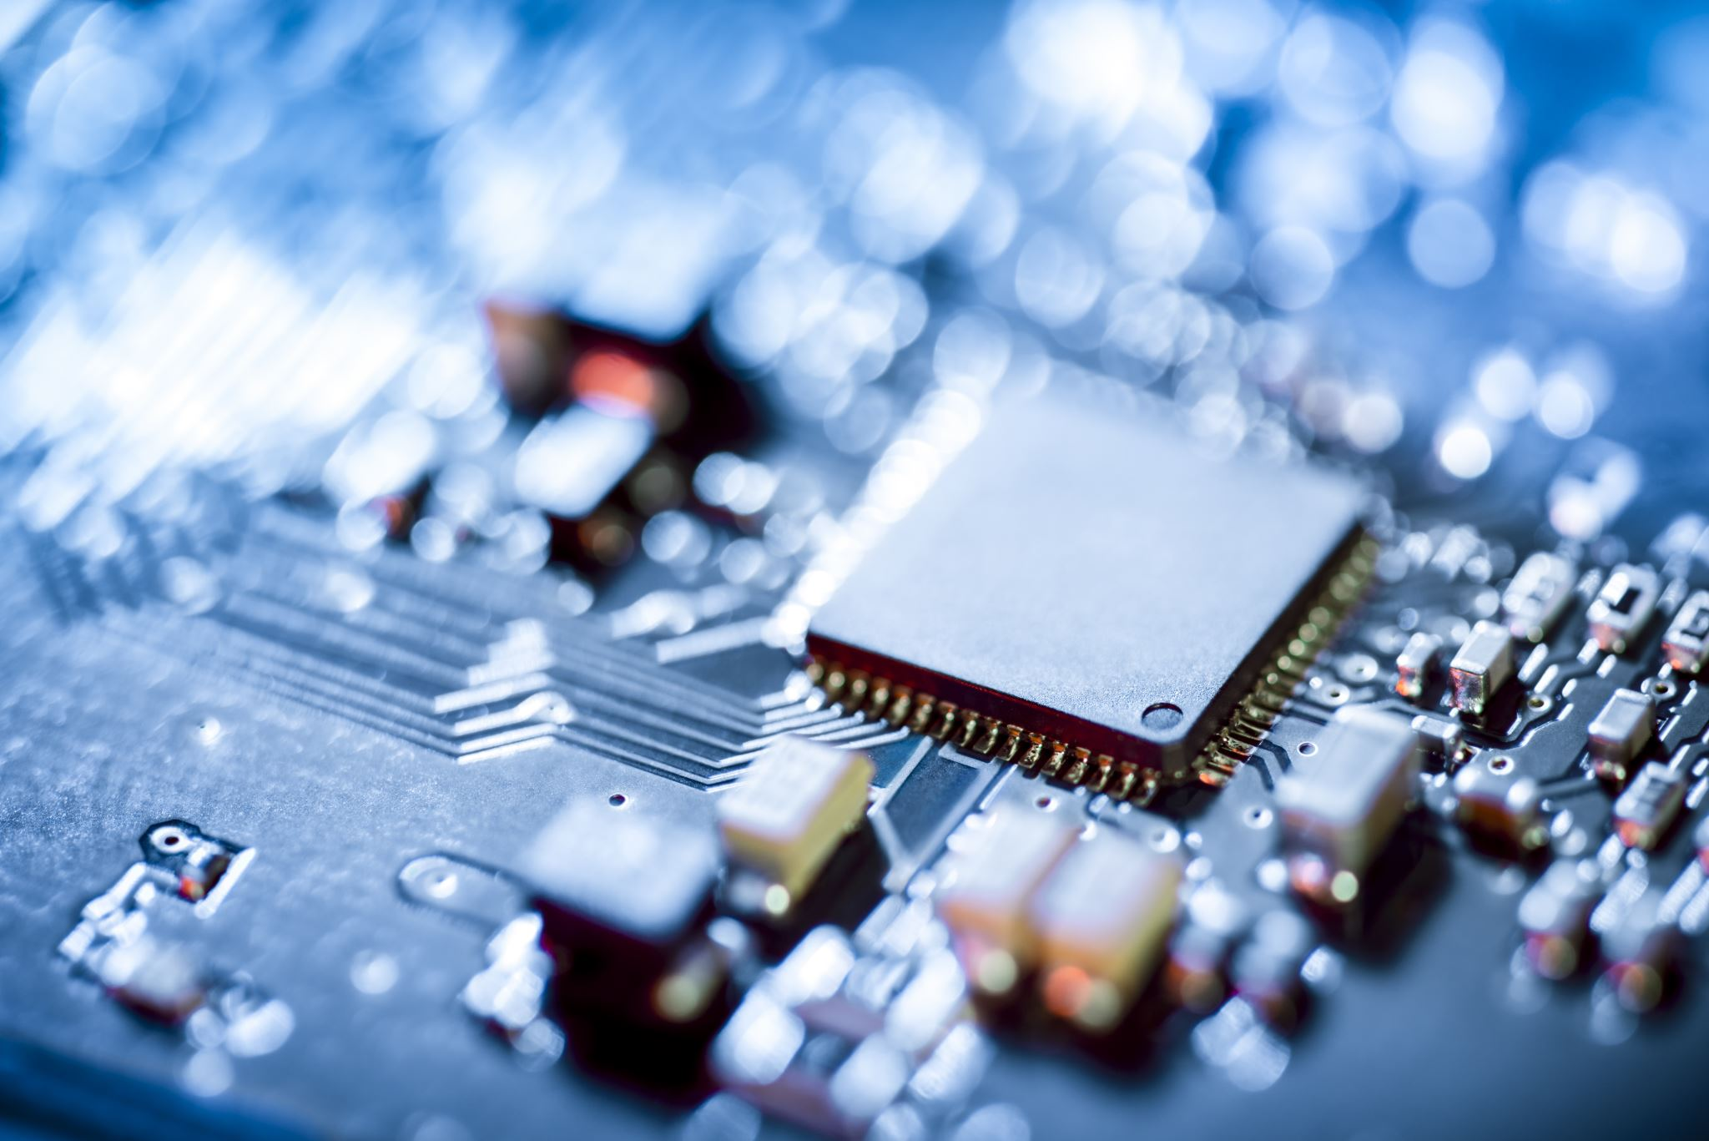
Environments
In the context of computing, the environment refers to the set of hardware, software and other system components that define where and how a program or process operates.
Each type of environment in computing provides a controlled setting where specific configurations, dependencies, and parameters ensure that software run correctly and consistently across systems.

Slide 35
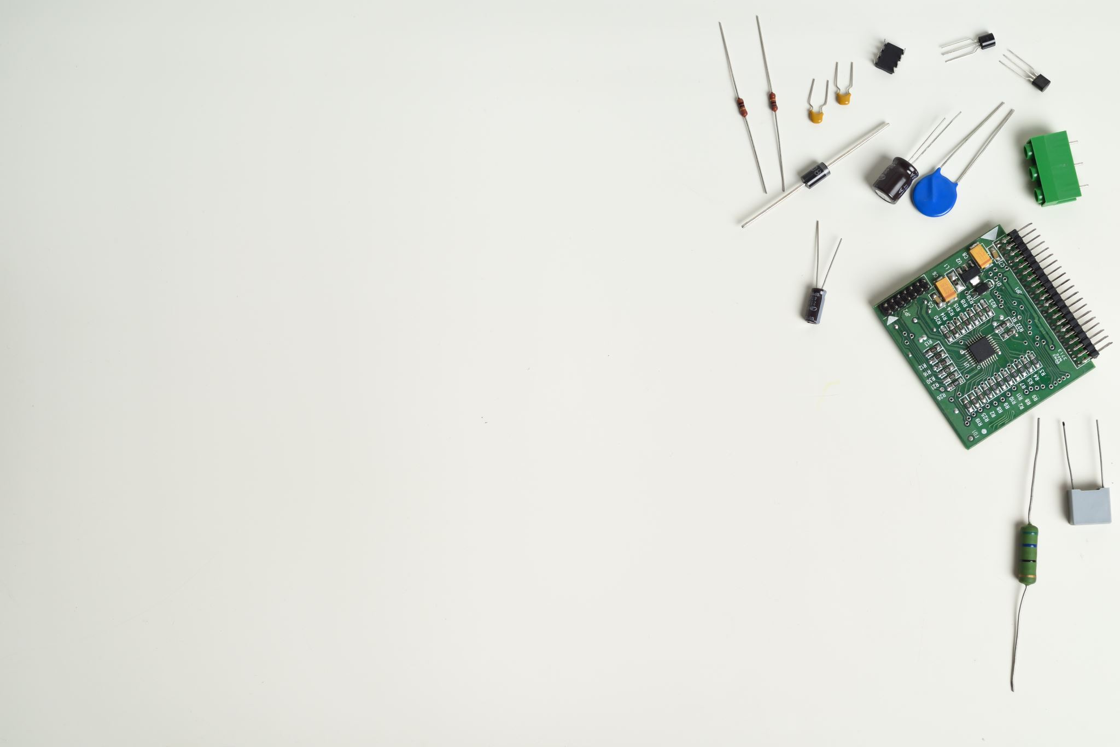
Hardware Environment
A hardware computing environment refers to the tangible, hardware-based infrastructure that supports computing tasks. This environment consists of the physical devices and components required for running software applications and managing data.
The physical computing environment is crucial because it forms the foundation upon which all software operations occur. Without it, virtual environments (cloud-based or otherwise) wouldn’t have the necessary infrastructure to function.

Slide 36

Development Environment
Within computing, a development environment is a set of tools, resources and configurations that software developers use to write, test, debug and maintain code during the software development lifecycle.
It includes IDE’s (Integrated Development Environments), version control systems, and testing frameworks, providing the resources to streamline the development process.
The environment may be local, remote, or cloud-based, and often integrates with continuous integration and testing tools to ensure smooth progression from coding to deployment.

Slide 37
Virtual Environment
A virtual environment refers to a simulated, software-based environment that mimics a physical computing environment but exists within a host system.
It allows application or processes to run independently of the underlying hardware or operating system, providing flexibility and isolation.
They provide an isolated and controlled space where software applications can be run without affecting or being affected by other systems.
This abstraction allows for better resource management, flexibility, and easier development and deployment across different platforms.

Slide 38
Testing Environment
A testing environment is a setup that replicates the conditions of a production environment where software applications or systems are tested before being deployed to actual users.
It is designed to verify the functionality, performance, security, and reliability of software by running tests in an isolated and controlled environment that mimics real-world scenarios.
The testing environment is separate from the production environment, ensuring that the testing activities do not interfere with the live application or system used by actual users.

Slide 39
Environments
There are a number of reasons why multiple environments are required within computer systems.
Including but by no means limited to :
Isolated testing in testing environments, which provide a sandbox for validating software before it reaches users.
Different environments act as a buffer to prevent mistakes form propagating to the live system, therefore providing risk mitigation.
Different environments separate tasks, ensuring that issues encountered during development or testing don’t impact that live production environment

